Slide 1
Lecture # 2 (Final) Pulse Width Modulation (PWM)

Slide 2
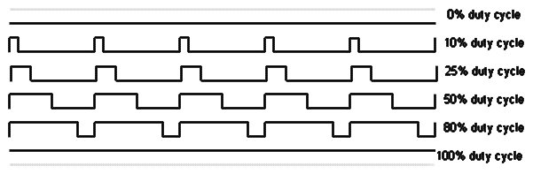
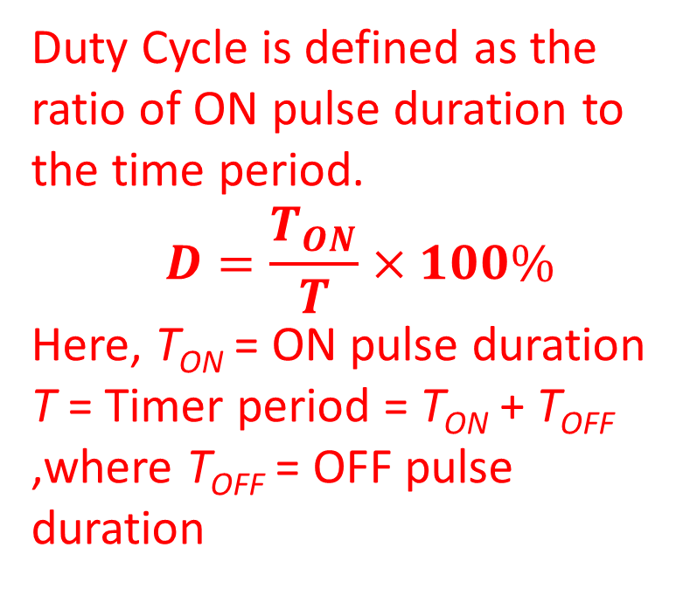
PWM
Pulse Width Modulation, or PWM, is a technique for getting analog results with digital means. Digital control is used to create a square wave, a signal switched between on and off. This on-off pattern can simulate voltages in between the full V_{CC} of the board (e.g., 5 V on UNO) and off (0 Volts). The duration of "on time" is called the pulse width. To get varying analog values, the pulse width can be varied. If this on-off pattern is repeated fast enough with an LED, for example, the result is as if the signal is a steady voltage between 0 and V_{CC} controlling the brightness of the LED.
Duty Cycle is defined as the ratio of ON pulse duration to the time period.
$$D=\frac{T_{ON}}{T}×100\%$$
Here, T_{ON} = ON pulse duration
T = Timer period = T_{ON} + T_{OFF} ,where T_{OFF} = OFF pulse duration
T_{ON}
T_{OFF}

Slide 3
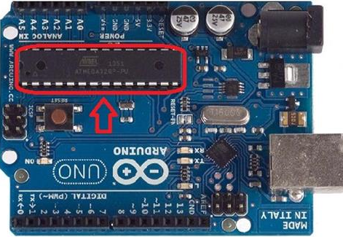
PWM
PWM
The Arduino’s programming language makes PWM easy to use; simply call the built-in function analogWrite(pin, dutyCycle), where dutyCycle is a value from 0 to 255, and pin is one of the PWM pins (3, 5, 6, 9, 10, or 11).
The analogWrite() function provides a simple interface to the hardware PWM, but doesn’t provide any control over frequency.
Note the tilde ~ sign with the pin numbers of the image.

Slide 4


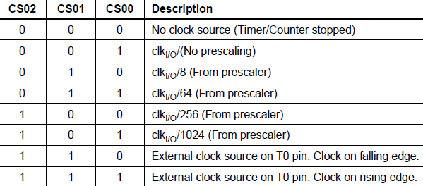



PWM
PWM
The main PWM modes are "Fast PWM" and "Phase-correct PWM“.
There are two Fast PWM modes for Timer/Counter 0 unit. These are modes 3 and 7, which are selected using the waveform generation mode bits (WGM02, WGM01, and WGM00). The WGM01 and WGM00 bits are located in the TCCR0A register. The WGM02 bit is located in the TCCR0B register.
There are 2 types of Fast PWM modes: (a) Non-inverting and (b) Inverting Fast PWM

Slide 5
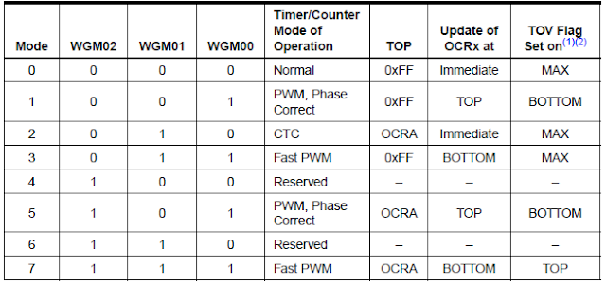
PWM
The difference between the mode 3 and mode 7 Fast PWMs is their TOP values.
For mode 3, the TOP value is fixed (0xFF), whereas that for mode 7 is OCRnA value.
So, if mode 7 is used then we have to load a count value into the OCRnA register.
Once a mode is selected, the timer/counter starts counting from BOTTOM to TOP value and when the TOP value is reached the counting is repeated from BOTTOM.
The table in the right shows the WGM bits combination for mode 3 and mode 7.

Slide 6
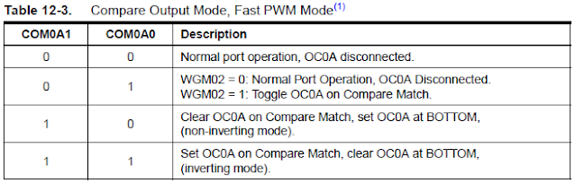
Fast PWM Mode: Setting Modes
In the fast PWM mode, the Compare Output Mode bits COM0A1, COM0A0 (in the TCCR0A register) for the output at OC0A and bits COM0B1, COM0B0 (in the TCCR0A register) for the output at OC0B, are used to configure the output as either non-inverting or inverting mode of operation. Table 12-3 shows how to select COM0A1, COM0A0 bits to generate non-inverting and inverting mode’s fast PWM waveform.

Slide 7
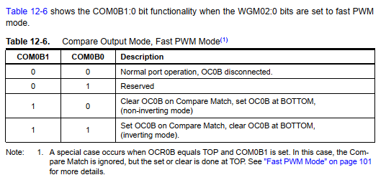
Fast PWM Mode: Setting Modes
In the fast PWM mode, the compare unit allows the generation of PWM waveforms on the OC0x pins. Table 12.6 shows the COM0B1:0 bit functionality when the WGM02:0 bits are set to the fast PWM mode.

Slide 8


Fast PWM Mode: Setting Modes
Setting the COM0x1:0 bits to 10 will produce a non-inverted PWM and an inverted PWM output can be generated by setting the COM0x1:0 to 11.
Setting the COM0A1:0 bits to 01 allows the OC0A pin to toggle on Compare Matches if the WGM02 bit is set. This option is not available for the OC0B pin (see Table 12-6 ).

Slide 9
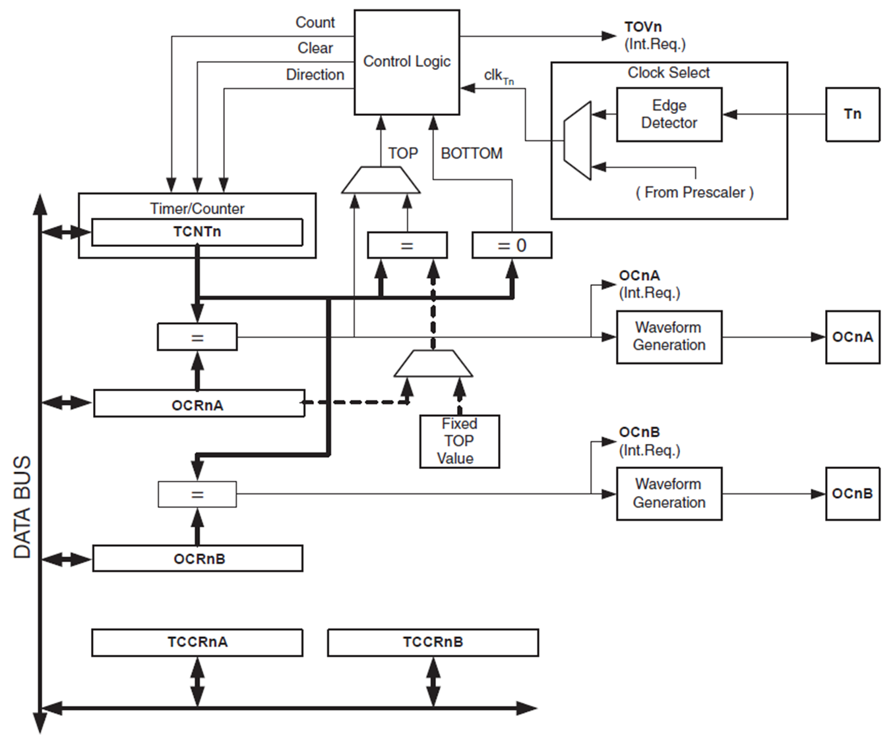
Fast PWM Mode
The Fast Pulse Width Modulation or Fast PWM Mode (WGM02:0 = 3 or 7) provides a high-frequency PWM waveform generation option. The Fast PWM differs from the other PWM option in its single-slope operation.
The counter starts counting from BOTTOM to TOP and then restarts from BOTTOM.
In Non-inverting Compare Output Mode, the Output Compare (OC0x) is cleared on the compare match between TCNT0 and OCR0x, and set at BOTTOM.
In Inverting Compare Output Mode, the output is set on compare match and cleared at BOTTOM.

Slide 10
Fast PWM Mode
Due to the single-slope operation, the operating frequency of the Fast PWM mode can be twice as high as the phase correct PWM mode that uses dual-slope operation.
This high frequency makes the fast PWM mode well suited for power regulation, rectification, and DAC applications.
High frequency allows physically small-sized external components (coils, capacitors), and therefore reduces the total system cost.
In fast PWM mode, the counter is incremented until the counter value matches the TOP value, the register TCNTn counts from bottom value to maximum value stored in the register OCRn. The counter is then cleared/reset to zero at the following timer clock cycle. If the timer is configured in non-inverting mode, PWM output pin (OCn) goes low when the value of the above two registers matches. The OCn pin becomes high when the TCNTn register reaches at bottom value. In inverting mode, OCn pin behaves opposite to non-inverting mode.

Slide 11
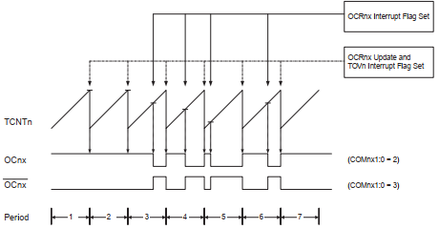
Fast PWM Mode
The timing diagram for the Fast PWM Mode is shown in Figure 12.6.
The TCNT0 value is in the timing diagram shown as a histogram for illustrating the single-slope operation.
The diagram includes non-inverted and inverted PWM outputs.
The small horizontal line marks on the TCNT0 slopes represent compare matches between OCR0x and TCNT0.
Fig. 12.6 Timing Diagram of Fast PWM Mode

Slide 12
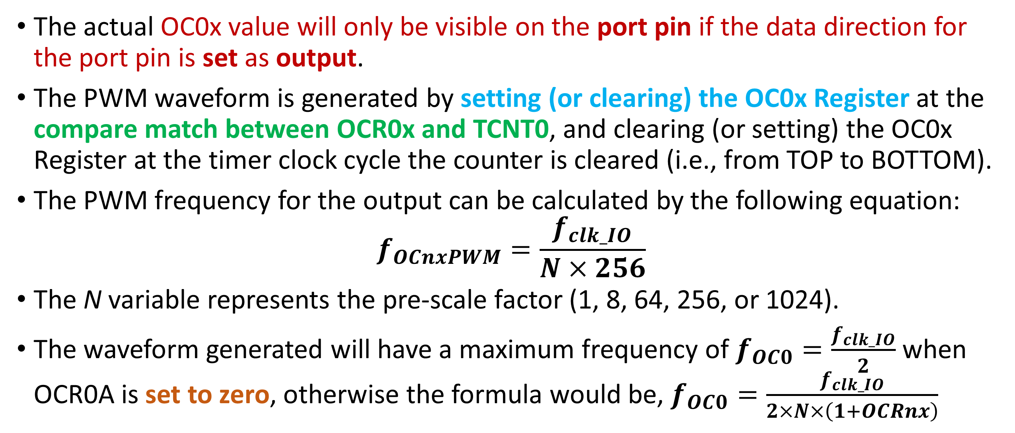
Fast PWM Mode: Output Frequency
The actual OC0x value will only be visible on the port pin if the data direction for the port pin is set as output.
The PWM waveform is generated by setting (or clearing) the OC0x Register at the compare match between OCR0x and TCNT0, and clearing (or setting) the OC0x Register at the timer clock cycle the counter is cleared (i.e., from TOP to BOTTOM).
The PWM frequency for the output can be calculated by the following equation:
$$f_{OCnxPWM}=\frac{f_{clk_IO}}{N×256}$$
The N variable represents the pre-scale factor (1, 8, 64, 256, or 1024).
The waveform generated will have a maximum frequency of $f_{OC0}=\frac{f_{clk_IO}}{2}$ when OCR0A is set to zero, otherwise the formula would be, $f_{OC0}=\frac{f_{clk_IO}}{2×N×\left(1+OCRnx\right)}$

Slide 13
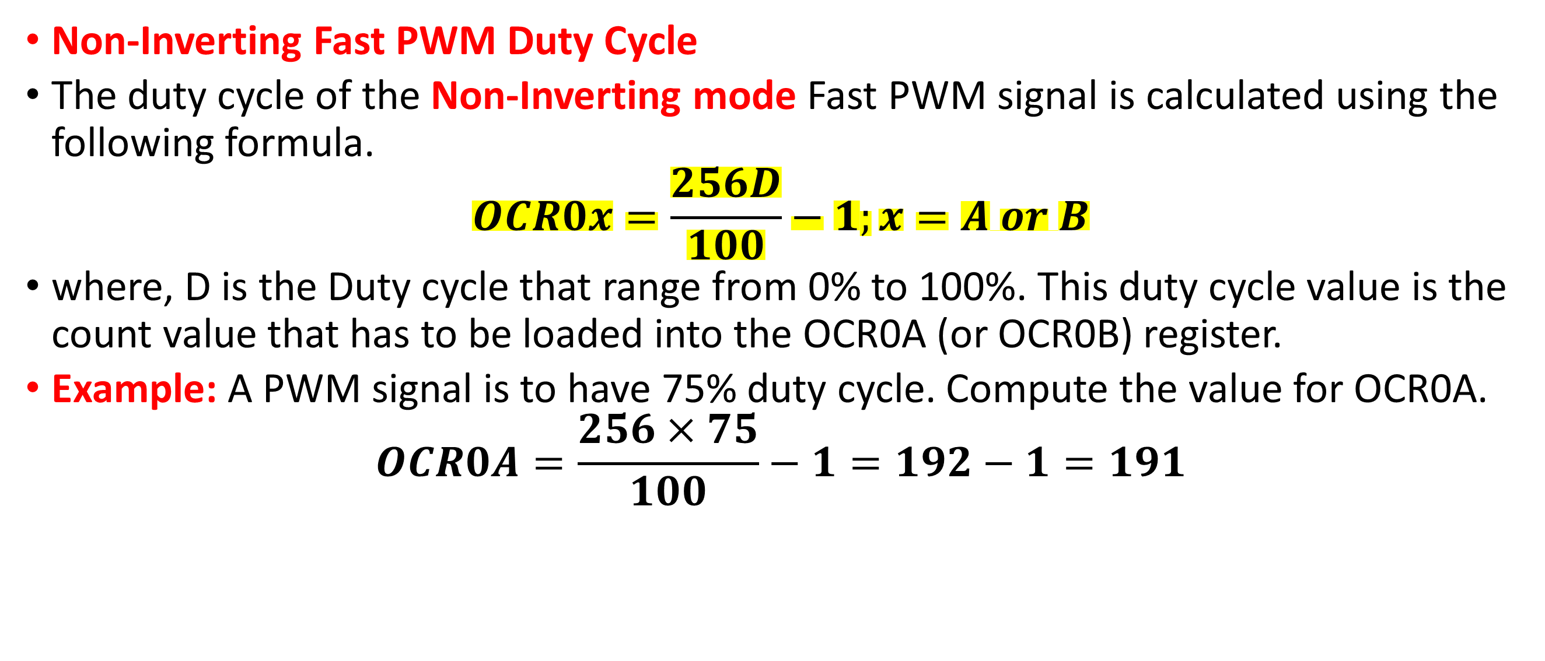
Fast PWM Mode: Output Frequency
Non-Inverting Fast PWM Duty Cycle
The duty cycle of the Non-Inverting mode Fast PWM signal is calculated using the following formula.
$$OCR0x=\frac{256D}{100}−1;x=A or B$$
where, D is the Duty cycle that range from 0% to 100%. This duty cycle value is the count value that has to be loaded into the OCR0A (or OCR0B) register.
Example: A PWM signal is to have 75% duty cycle. Compute the value for OCR0A.
$$OCR0A=\frac{256×75}{100}−1=192−1=191$$

Slide 14
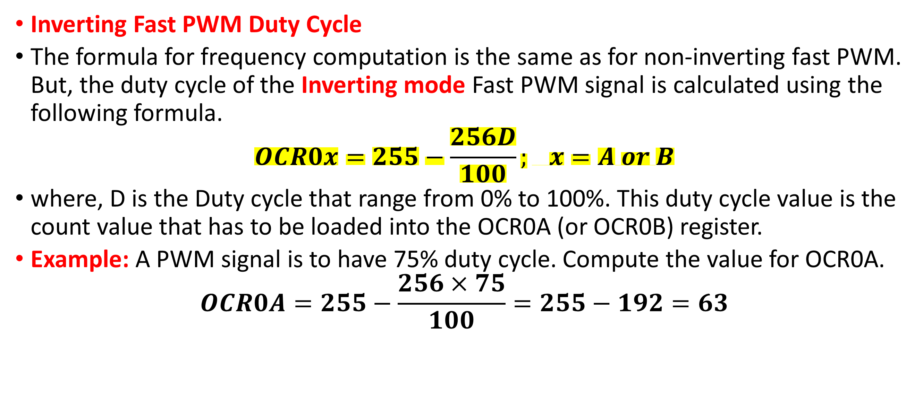
Fast PWM Mode: Output Frequency
Inverting Fast PWM Duty Cycle
The formula for frequency computation is the same as for non-inverting fast PWM. But, the duty cycle of the Inverting mode Fast PWM signal is calculated using the following formula.
$$OCR0x=255−\frac{256D}{100}; x=A or B$$
where, D is the Duty cycle that range from 0% to 100%. This duty cycle value is the count value that has to be loaded into the OCR0A (or OCR0B) register.
Example: A PWM signal is to have 75% duty cycle. Compute the value for OCR0A.
$$OCR0A=255−\frac{256×75}{100}=255−192=63$$

Slide 15
Phase correct PWM Mode
The phase correct PWM mode (WGM02:0 = 1 or 5) provides a high-resolution phase correct PWM waveform generation option. The phase correct PWM mode is based on a dual-slope operation. The counter counts repeatedly from BOTTOM to TOP and then from TOP to BOTTOM.
In non-inverting Compare Output mode, the Output Compare (OC0x) is cleared on the compare match between TCNT0 and OCR0x while up counting, and set on the compare match while down counting.
In inverting Output Compare mode, the operation is inverted.
The dual-slope operation has a lower maximum operation frequency than the single-slope operation.
However, due to the symmetric feature of the dual-slope PWM modes, these modes are preferred for motor control applications.

Slide 16
Phase correct PWM Mode
In phase correct PWM mode, the counter is incremented until the counter value matches TOP. When the counter reaches TOP, it changes the count direction.
The TCNT0 value will be equal to TOP for one timer clock cycle. The timing diagram for the phase correct PWM mode is shown on Figure 12.7.
The TCNT0 value is in the timing diagram shown as a histogram for illustrating the dual-slope operation.
The diagram includes non-inverted and inverted PWM outputs.
The small horizontal line marks on the TCNT0 slopes represent compare matches between OCR0x and TCNT0.

Slide 17
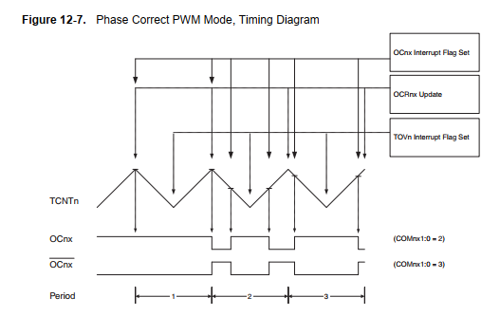

Phase correct PWM Mode
The diagram includes non-inverted and inverted PWM outputs.
The small horizontal line marks on the TCNT0 slopes represent compare matches between OCR0x and TCNT0.
The Timer/Counter Overflow Flag (TOV0) is set each time the counter reaches BOTTOM.
The Interrupt Flag can be used to generate an interrupt each time the counter reaches the BOTTOM value.
Figure 12.7 Timing Diagram of the Phase Correct PWM Mode

Slide 18
Phase-Correct PWM Mode: Setting Modes
The OCR0x Registers are double buffered when using any of the Pulse Width Modulation (PWM) modes. For the normal and Clear Timer on Compare (CTC) modes of operation, the double buffering is disabled.
The double buffering synchronizes the update of the OCR0x Compare Registers to either top or bottom of the counting sequence.
Figure 12-3. Output Compare Unit, Block Diagram

Slide 19
Phase-Correct PWM Mode: Setting Modes
The Compare Output mode (COM0x1:0) bits have two functions. The Waveform Generator uses the COM0x1:0 bits for defining the Output Compare (OC0x) state at the next compare match.
Also, the COM0x1:0 bits control the OC0x pin output source. Figure 12-4 shows a simplified schematic of the logic affected by the COM0x1:0 bit setting.
Figure 12-4. Compare Match Output Unit, Schematic

Slide 20
Phase Correct PWM Mode
In Phase Correct PWM mode, the compare unit allows the generation of PWM waveforms on the OC0x pins. Table 12.4 shows the COM0A1:0 bit functionality when the WGM02:0 bits are set to Phase Correct PWM mode.

Slide 21
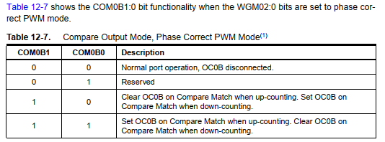
Phase Correct PWM Mode
In Phase Correct PWM mode, the compare unit allows the generation of PWM waveforms on the OC0x pins. Table 12.7 shows the COM0B1:0 bit functionality when the WGM02:0 bits are set to Phase Correct PWM mode.

Slide 22
Phase Correct PWM Mode
In phase correct PWM mode, the compare unit allows the generation of PWM waveforms on the OC0x pins. Setting the COM0x1:0 bits to 10 will produce a non-inverted PWM.
An inverted PWM output can be generated by setting the COM0x1:0 to 11.
Setting the COM0A0 bits to 01 allows the OC0A pin to toggle on Compare Matches if the WGM02 bit is set. This option is not available for the OC0B pin (Table 12-7).

Slide 23
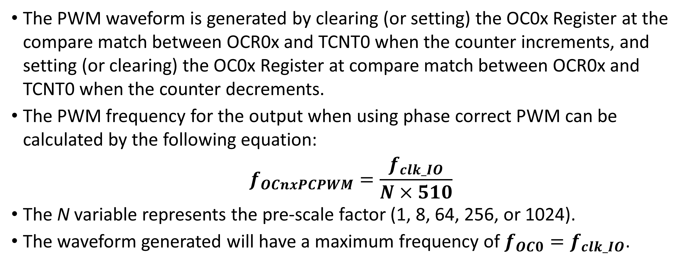
Phase correct PWM Mode
The PWM waveform is generated by clearing (or setting) the OC0x Register at the compare match between OCR0x and TCNT0 when the counter increments, and setting (or clearing) the OC0x Register at compare match between OCR0x and TCNT0 when the counter decrements.
The PWM frequency for the output when using phase correct PWM can be calculated by the following equation:
$$f_{OCnxPCPWM}=\frac{f_{clk_IO}}{N×510}$$
The N variable represents the pre-scale factor (1, 8, 64, 256, or 1024).
The waveform generated will have a maximum frequency of $f_{OC0}=f_{clk_IO}$.

Slide 24
Phase correct PWM Mode
The extreme values for the OCR0A Register represent special cases when generating a PWM waveform output in the phase correct PWM mode.
If the OCR0A is set equal to BOTTOM, the output will be continuously low and if set equal to MAX the output will be continuously high for non-inverted PWM mode.
For inverted PWM, the output will have the opposite logic values.

Slide 25
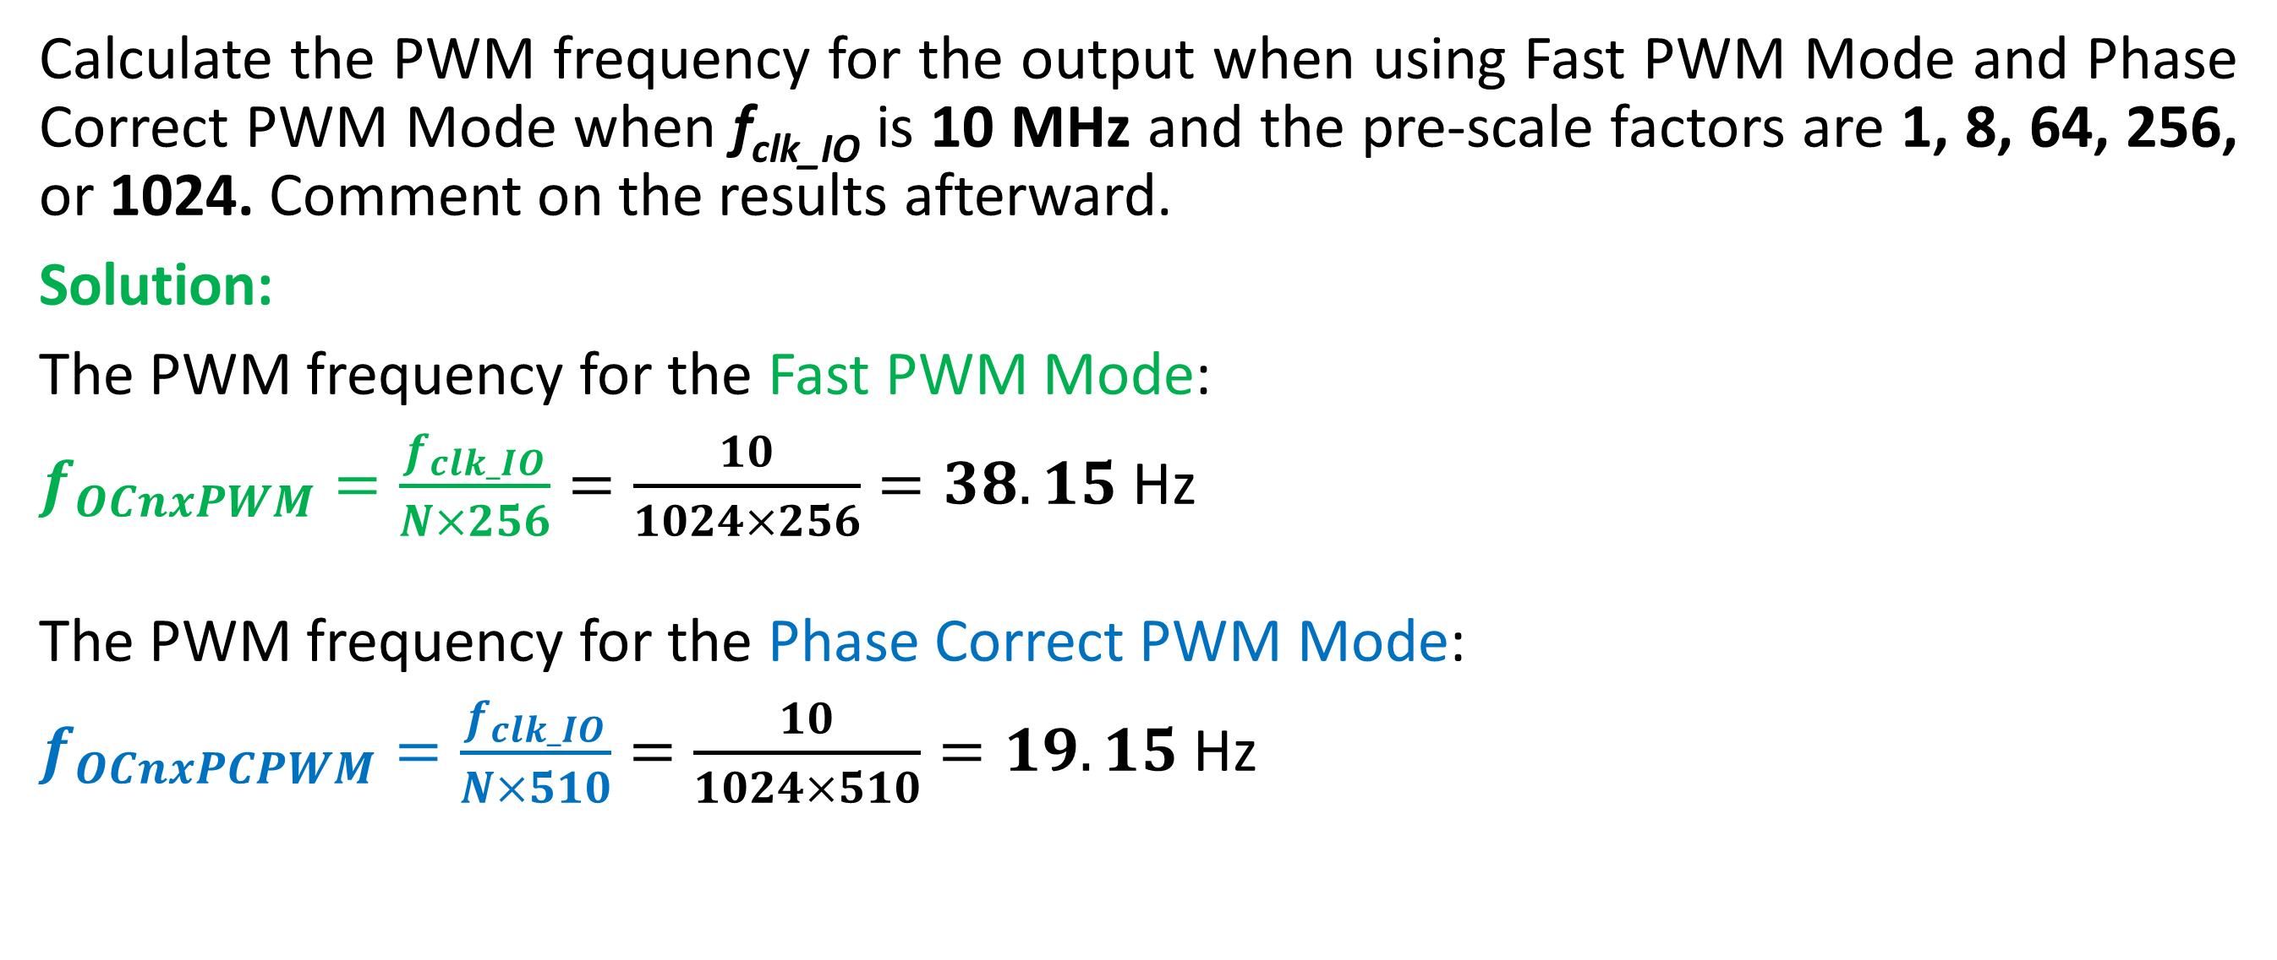
Example to Self practice:
Calculate the PWM frequency for the output when using Fast PWM Mode and Phase Correct PWM Mode when f_{clk_IO} is 10 MHz and the pre-scale factors are 1, 8, 64, 256, or 1024. Comment on the results afterward.
Solution:
The PWM frequency for the Fast PWM Mode:
$f_{OCnxPWM}=\frac{f_{clk_IO}}{N×256}=\frac{10}{1024×256}=38.15$ Hz
The PWM frequency for the Phase Correct PWM Mode:
$f_{OCnxPCPWM}=\frac{f_{clk_IO}}{N×510}=\frac{10}{1024×510}=19.15$ Hz

Slide 26
Important!
Note that in those WGM modes where OCR0A sets the frequency (modes 2, 5, and 7) then you can't do PWM on channel A (because OCR0A couldn't be used for two things at once, i.e., setting both PWM frequency and duty cycle!).
So, the only active PWM channel in those modes is channel B and you set the duty cycle of that (as always) with OCR0B (set to some value between 0 and the OCR0A upper limit). As such, the PWM output will be on pin 11 (PD5).
The PWM output for channel A with OCR0A will be on pin 12 (PD6).
Timer Output | Arduino Output | Chip Pin | Pin Name | Port Name
OC0A | 6 | 12 | PD6 | Port D
OC0B | 5 | 11 | PD5 | Port D
OC1A | 9 | 15 | PB1 | Port B
OC1B | 10 | 16 | PB2 | Port B
OC2A | 11 | 17 | PB3 | Port B
OC2B | 3 | 5 | PD3 | Port D

Slide 27
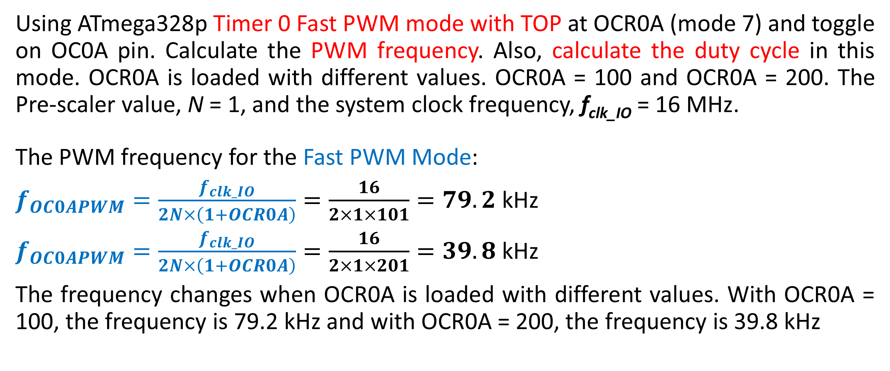
Example for Practice
Using ATmega328p Timer 0 Fast PWM mode with TOP at OCR0A (mode 7) and toggle on OC0A pin. Calculate the PWM frequency. Also, calculate the duty cycle in this mode. OCR0A is loaded with different values. OCR0A = 100 and OCR0A = 200. The Pre-scaler value, N = 1, and the system clock frequency, f_{clk_IO} = 16 MHz.
The PWM frequency for the Fast PWM Mode:
$f_{OC0APWM}=\frac{f_{clk_IO}}{2N×\left(1+OCR0A\right)}=\frac{16}{2×1×101}=79.2$ kHz
$f_{OC0APWM}=\frac{f_{clk_IO}}{2N×\left(1+OCR0A\right)}=\frac{16}{2×1×201}=39.8$ kHz
The frequency changes when OCR0A is loaded with different values. With OCR0A = 100, the frequency is 79.2 kHz and with OCR0A = 200, the frequency is 39.8 kHz

Slide 28
Programming Arduino for Fast PWM
#ifndef F_CPU
#define F_CPU 8000000UL // Clock frequency is 8 MHz
#endif
#include <avr/io.h>
int main() {
// OC0B pin is set as PWM output pin by sending a HIGH to Port D’s Data Direction Register, DDRD
DDRD |= (1<<PD5);
OCR0B= 191; // Load 191 into OCR0B for setting its duty cycle to 75% (See previous example)
// Configure TCCR0A and TCCR0B register for (i) non-inverting (10), (ii) Fast PWM mode 7 (111), (iii) No
// Pre-scalar (001) for frequency control. By default, 0s are there, but you may set them explicitly.
TCCR0A |= (1 << COM0B1) | (1<<WGM01) | (1<<WGM00);
TCCR0B |= (1<<CS00) | (1<<WGM02);
// TCC0A = 0b00100011; TCC0B = 0b00001001;
// TCC0A = 0x23; TCC0B = 0x10
while(1);
return 0;
}
Timer Output | Arduino Output | Chip Pin | Pin Name | Port Name
OC0A | 6 | 12 | PD6 | Port D
OC0B | 5 | 11 | PD5 | Port D
OC1A | 9 | 15 | PB1 | Port B
OC1B | 10 | 16 | PB2 | Port B
OC2A | 11 | 17 | PB3 | Port B
OC2B | 3 | 5 | PD3 | Port D

Slide 29
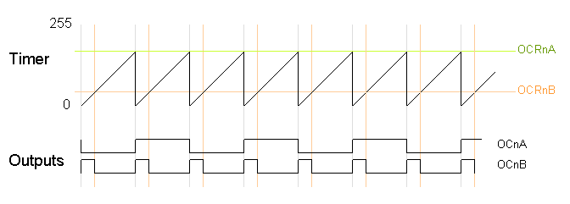
Programming Arduino for Fast PWM: Varying the Timer Top Limit
The timer resets when it matches OCRnA, yielding a faster output frequency for OCnB. Note how OCnA toggles once for each timer reset. Here is the diagram
Fast PWM with OCRnA value as the TOP

Slide 30
Programming Arduino for Fast PWM
#ifndef F_CPU
#define F_CPU 8000000UL // Clock frequency is 8 MHz
#endif
#include <avr/io.h>
int main() {
// OC0B pin is set as PWM output pin by sending a HIGH to Port D’s Data Direction Register, DDRD
DDRD |= (1<<PD5);
OCR0A = 200; // Top Value of 200 (must be equal or greater than the value in the OCR0B)
OCR0B= 191; // Load 191 into OCR0B for setting its duty cycle to 75% (See previous example)
// Configure TCCR0A and TCCR0B register for (i) non-inverting (10), (ii) Fast PWM mode 7 (111), (iii) No
// Pre-scalar (001) for frequency control. By default, 0s are there, but you may set them explicitly.
TCCR0A |= (1 << COM0B1) | (1 << COM0A0) | (1<<WGM01) | (1<<WGM00);
TCCR0B |= (1<<WGM02) | (1<<CS00);
// TCC0A = 0b01100011 = 0x63; TCC0B = 0b00001001 = 0x09;
while(1);
return 0;
}

Slide 31
Programming Arduino for Fast PWM
#ifndef F_CPU
#define F_CPU 8000000UL // Clock frequency is 8 MHz
#endif
#include <avr/io.h>
int main() {
// OC0A pin is set as PWM output pin by sending a HIGH to Port D’s Data Direction Register, DDRD
DDRD |= (1<<PD6);
OCR0A= 63; // Load 63 into OCR0A for setting its duty cycle to 75% (See previous example)
// Configure TCCR0A and TCCR0B register for (i) inverting (11), (ii) Fast PWM mode 7 (111), (iii) No
// Pre-scalar (001) for frequency control. By default, 0s are there, but you may set them explicitly.
TCCR0A |= (1 << COM0A1) | (1 << COM0A0) | (1<<WGM01) | (1<<WGM00);
TCCR0B |= (1<<CS00) | (1<<WGM01);
// TCC0A = 0b11000011 = 0xC3; TCC0B = 0b00001011 = 0x12;
while(1);
return 0;
}

Slide 32
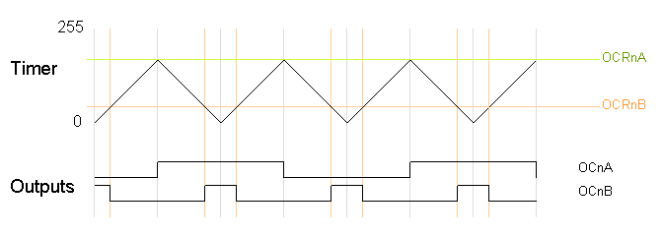
Programming Arduino for Phase-Correct PWM
The next code fragment sets up phase-correct PWM on pins 3 and 11 of the Timer 2 using the value of OCR2A as the TOP value for the timer. The waveform generation mode bits WGM2x are set to 101 for phase-correct PWM (mode 5) with OCR2A controlling the TOP limit. The OCR2A TOP limit is arbitrarily set to 180, and the OCR2B compare register is arbitrarily set to 50 (this value must be less than or equal to the value stored in the OCR2A. The mode of the OCR2A register is set to “Toggle on Compare Match” by setting the COM2A bits to 01.
The timer can be configured in phase-correct PWM mode to reset when it reaches OCRnA.
Phase-Correct PWM with OCRA top

Slide 33
Programming Arduino for Phase-Correct PWM
CS22
CS21
CS20
This is the program segment using Timer2:
The data direction register of port D must be set
DDRB |= (1<<PB3);
DDRD |= (1<<PD3);
pinMode(3, OUTPUT);
pinMode(11, OUTPUT);
TCCR2A = _BV(COM2A0) | _BV(COM2B1) | _BV(WGM20);
TCCR2B = _BV(WGM22) | _BV(CS22);
OCR2A = 180;
OCR2B = 50;
Timer Output | Arduino Output | Chip Pin | Pin Name | Port Name
OC0A | 6 | 12 | PD6 | Port D
OC0B | 5 | 11 | PD5 | Port D
OC1A | 9 | 15 | PB1 | Port B
OC1B | 10 | 16 | PB2 | Port B
OC2A | 11 | 17 | PB3 | Port B
OC2B | 3 | 5 | PD3 | Port D

Slide 34
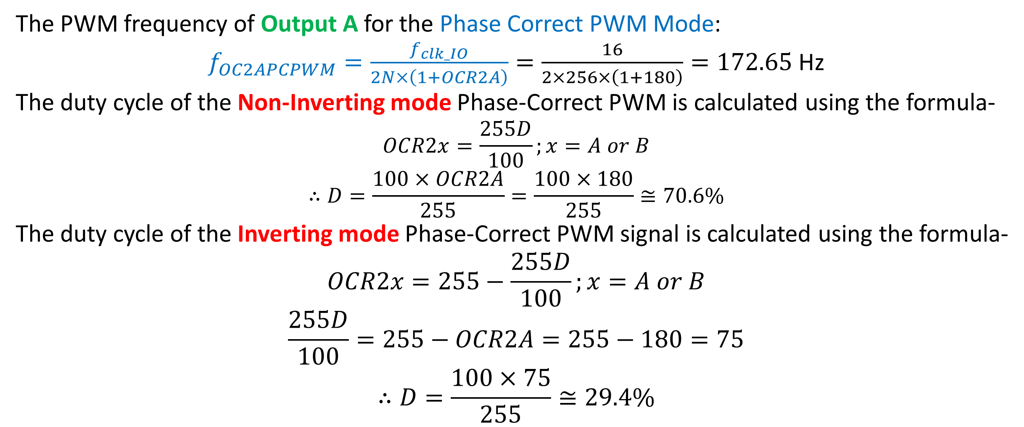
Programming Arduino for Phase-Correct PWM
The PWM frequency of Output A for the Phase Correct PWM Mode:
$f_{OC2APCPWM}=\frac{f_{clk_IO}}{2N×\left(1+OCR2A\right)}=\frac{16}{2×256×\left(1+180\right)}=172.65$ Hz
The duty cycle of the Non-Inverting mode Phase-Correct PWM is calculated using the formula-
$$OCR2x=\frac{255D}{100};x=A or B$$
$$∴D=\frac{100×OCR2A}{255}=\frac{100×180}{255}≅70.6\%$$
The duty cycle of the Inverting mode Phase-Correct PWM signal is calculated using the formula-
$$OCR2x=255−\frac{255D}{100};x=A or B$$
$$\frac{255D}{100}=255−OCR2A=255−180=75$$
$$∴D=\frac{100×75}{255}≅29.4\%$$

Slide 35
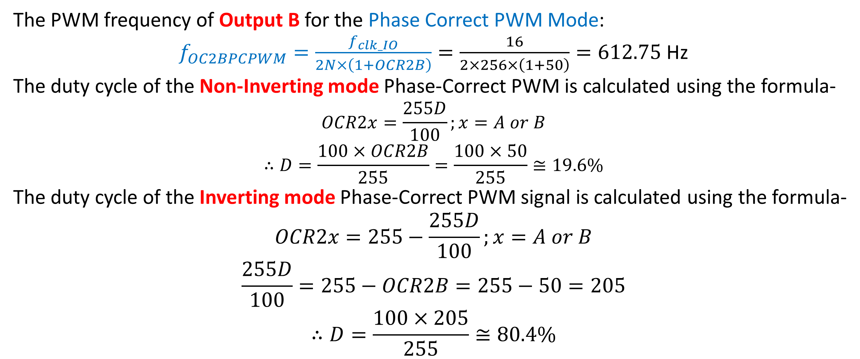
Programming Arduino for Phase-Correct PWM
The PWM frequency of Output B for the Phase Correct PWM Mode:
$f_{OC2BPCPWM}=\frac{f_{clk_IO}}{2N×\left(1+OCR2B\right)}=\frac{16}{2×256×\left(1+50\right)}=612.75$ Hz
The duty cycle of the Non-Inverting mode Phase-Correct PWM is calculated using the formula-
$$OCR2x=\frac{255D}{100};x=A or B$$
$$∴D=\frac{100×OCR2B}{255}=\frac{100×50}{255}≅19.6\%$$
The duty cycle of the Inverting mode Phase-Correct PWM signal is calculated using the formula-
$$OCR2x=255−\frac{255D}{100};x=A or B$$
$$\frac{255D}{100}=255−OCR2B=255−50=205$$
$$∴D=\frac{100×205}{255}≅80.4\%$$

Slide 36
Thanks for attending….
?

